Slide 1



ARELLANO UNIVERSITY
Jose Abad Santos Campus
Basic Education Department – Senior High School
3058 Taft Avenue, Pasay City
STATISTICS AND PROBABILITY

Slide 2
Prayer
Lord, we thank you a hundredfold
for the infinite love and care that you have given us.
May we, in return, multiply it with love and
respect and
add more faith.
Subtract the worldly desires and evil works in our minds and hearts and divide your given talents to all of us.
To sum it all, may we be unite as one in your family.
Amen

Slide 3
OBJECTIVES:
Define Sampling;
Identify Sampling Techniques;
Compute Statistics and Parameter.

Slide 4
SAMPLING TECHNIQUES

Slide 5
Any measurable characteristics
from a POPULATION.
PARAMETER
Any measurable characteristics
from a SAMPLE.
STATISTIC
The process of selecting members or elements of a sample from a given population
SAMPLING

Slide 6
SAMPLING TECHNIQUES
PROBABILITY
SAMPLING
NON-PROBABILITY
SAMPLING
Simple Random Sampling
Convenience Sampling
Systematic Random Sampling
Quota Sampling
Stratified Random Sampling
Snowball Sampling
Cluster Sampling
Volunteer Sampling

Slide 7
PROBABILITY SAMPLING
Is a sampling technique, in which the subjects of the population get an equal opportunity to be selected as a representative sample.

Slide 8
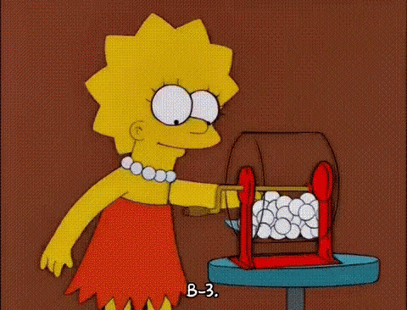
SIMPLE RANDOM SAMPLING
Sampling is done by drawing lots or through the use of random numbers.
Fish bowl method.
Example: A class list compromising of 50 names is cut into strips, rolled up, and put in a bowl. Ten strips (names) are then drawn from the bowl. The ten names That were picked are collectively called the simple random sample.

Slide 9
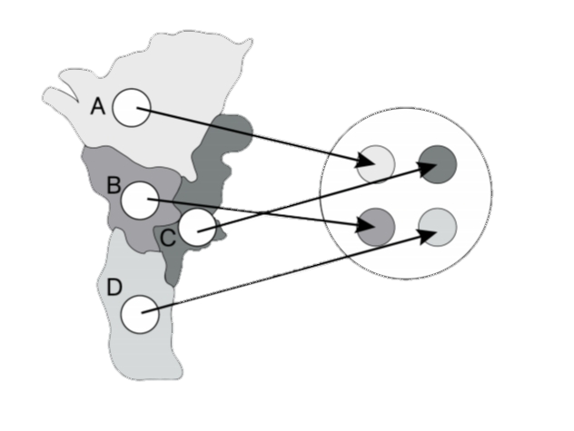
STRATIFIED RANDOM SAMPLING
Sampling is done by first dividing the population into a number of non-overlapping sub-populations or strata and then taking samples from each stratum.
Population
EQUAL ALLOCATION
Stratified Random Sampling
PROPORTIONAL ALLOCATION

Slide 10
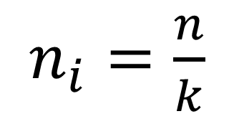
EQUAL ALLOCATION
$n_{i}=\frac{n}{k}$
Intended Sample Size
No. of Strata or Sub- population
Population
Stratified Random Sampling

Slide 11
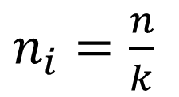
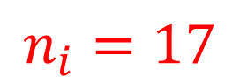
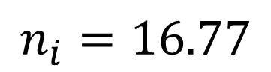
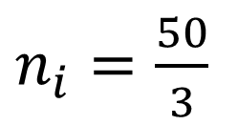
Example: A company is composed of 24 administrative staff, 38 support staff, and 52 electrical staff. You wish to conduct a work motivation survey on 50 staff. How many staff should be taken from each sub-population?
$n_{i}=\frac{n}{k}$
$n_{i}=\frac{50}{3}$
$$n_{i}=16.77$$
$$n_{i}=17$$
$$∴17 staff should be chosen from each group.$$

Slide 12
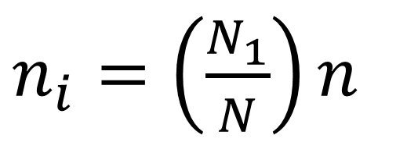
PROPORTIONAL ALLOCATION
Sub-Population or Stratum
$n_{i}=\left(\frac{N_{1}}{N}\right)n$
Intended Sample Size
Population Size

Slide 13
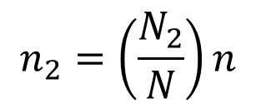
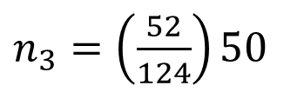
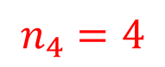
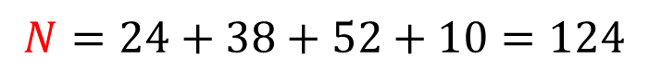
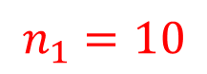
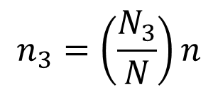
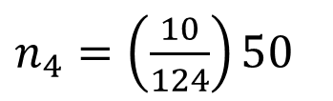
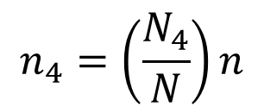
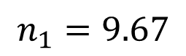
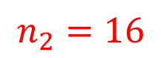
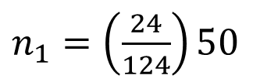
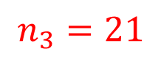
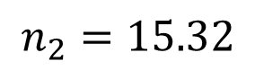
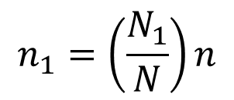
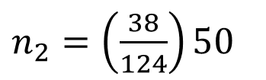
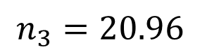
Example: A company is composed of 24 administrative staff, 38 support staff, 52 electrical staff and 10 contractual staff. You wish to conduct a work motivation survey on 50 staff. How many staff should be taken from each sub-population?
$$N=24+38+52+10=124$$
ADMINISTRATIVE
SUPPORT
ELECTRICAL
CONTRACTUAL
$$n_{1}=\left(\frac{N_{1}}{N}\right)n$$
$$n_{2}=\left(\frac{N_{2}}{N}\right)n$$
$$n_{3}=\left(\frac{N_{3}}{N}\right)n$$
$$n_{4}=\left(\frac{N_{4}}{N}\right)n$$
$n_{1}=\left(\frac{24}{124}\right)50$
$n_{2}=\left(\frac{38}{124}\right)50$
$n_{3}=\left(\frac{52}{124}\right)50$
$n_{4}=\left(\frac{10}{124}\right)50$
$$n_{1}=9.67$$
$$n_{2}=15.32$$
$$n_{3}=20.96$$
$$n_{4}=4$$
$$n_{1}=10$$
$$n_{2}=16$$
$$n_{3}=21$$

Slide 14
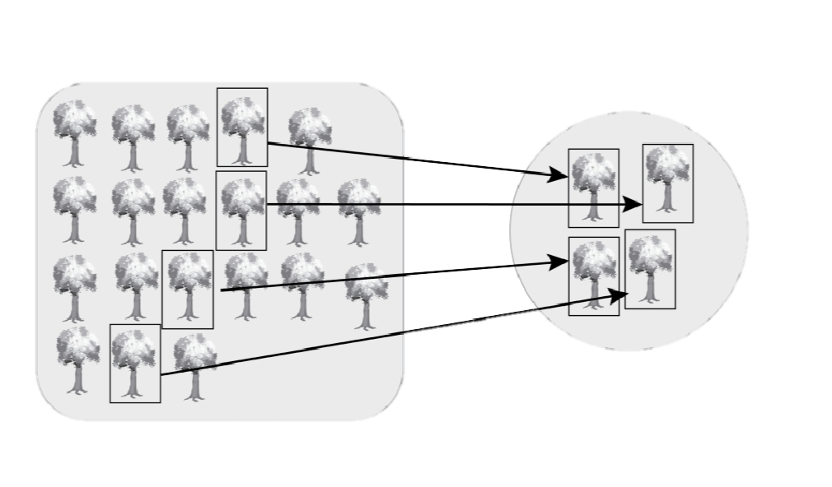
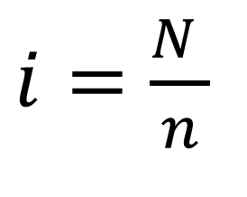
SYSTEMATIC RANDOM SAMPLING
Sampling is done by selecting every ith element in the population with the starting point determined at random.
$i=\frac{N }{n}$
Population Size
Sample Size
Stratified Random Sampling
Population

Slide 15
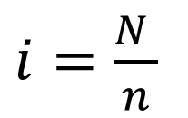
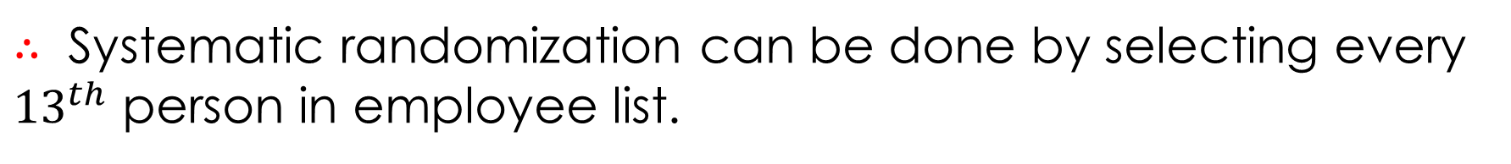
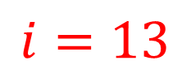
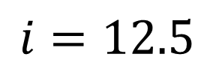
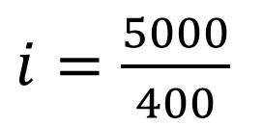
Example: If a company which has 5,000 employees wishes to conduct a job satisfaction survey on 400 employees, then
$i=\frac{N }{n}$
$i=\frac{5000}{400}$
$$i=12.5$$
$$i=13$$
$∴$Systematic randomization can be done by selecting every ${13}^{th}$ person in employee list.

Slide 16

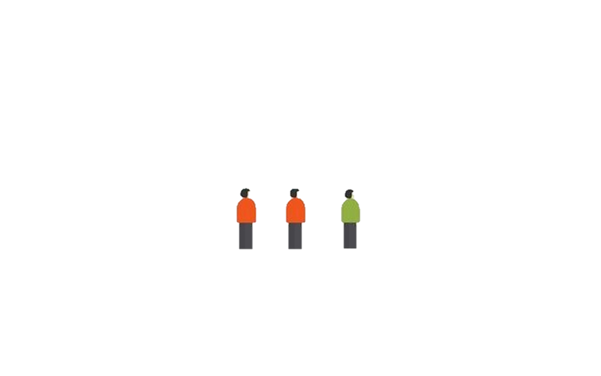


CLUSTER SAMPLING
Sampling is done by dividing the population into (geographical) groups called clusters.
CITY
1
2
3
4
DISTRICT 1
DISTRICT 2
DISTRICT 3
DISTRICT 4
2

Slide 17
NON-PROBABILITY SAMPLING
Samples are chosen in such a way that some members of the population may not have any chance of being included in the sample.

Slide 18
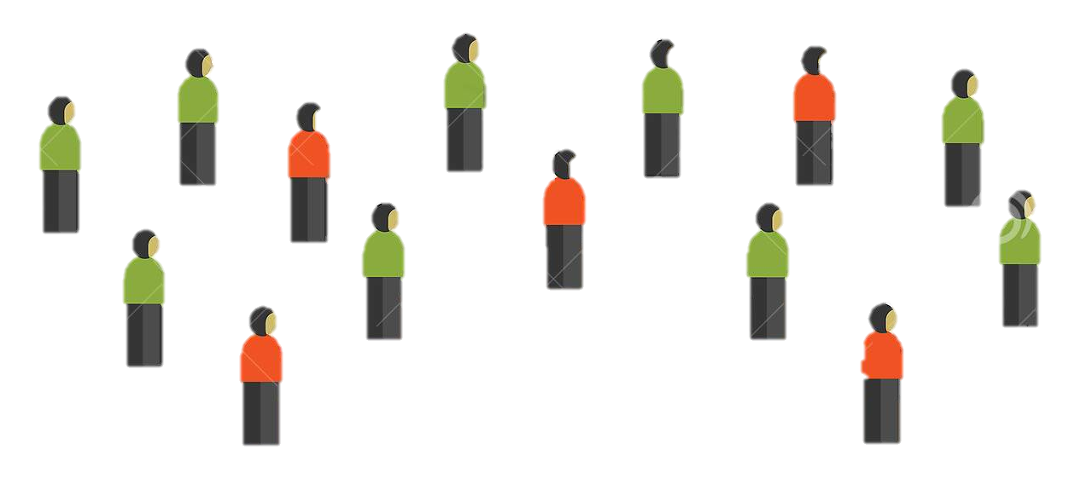

COVENIENCE SAMPLING
Selecting those members of the population that are readily available in order to obtain quick results
Population
What is your height?

Slide 19

QUOTA SAMPLING
Choosing members for the sample with no other criteria or objective but to obtain a certain target number whether or not based on the proportion of each stratum with the population
Population

Slide 20

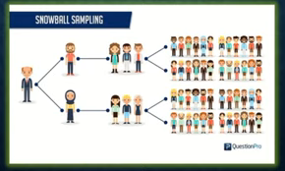
SNOWBALL SAMPLING
Snowball Sampling or chain-referral is defined as a non-probability sampling technique in w/c the samples have traits that are rare to find.

Slide 21
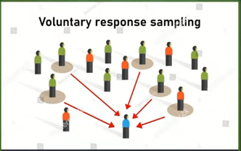
VOLUNTEER SAMPLING
VOLUNTEER SAMPLING
Voluntary sampling occurs when researchers seek volunteers to participate in studies. Volunteers can be solicited in person, over the internet, via public postings, and a variety of other methods. A researcher using voluntary sampling typically makes little effort to control sample composition.

Slide 22


